Slide 1
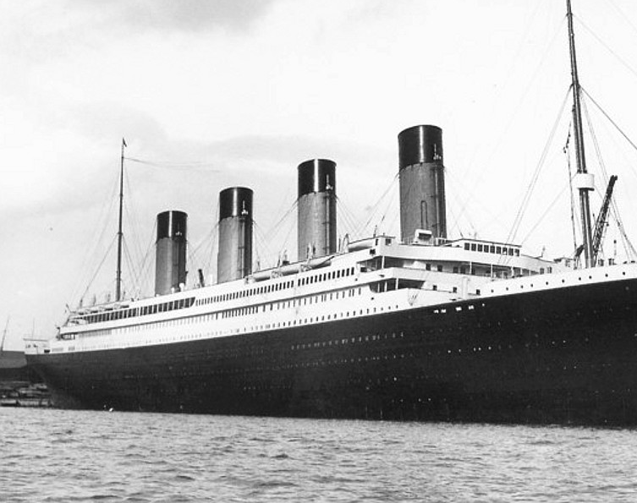
Cloud and Cognitive Services FROM TRAGEDY TO INSIGHT: MACHINE LEARNING ANALYSIS ON SURVIVAL ON THE TITANIC
Alejandro Acosta, Henry Becerra, Adel Reka Kalozdi, Karim Khazzaka, Roberto Antonio Mapa

Slide 2
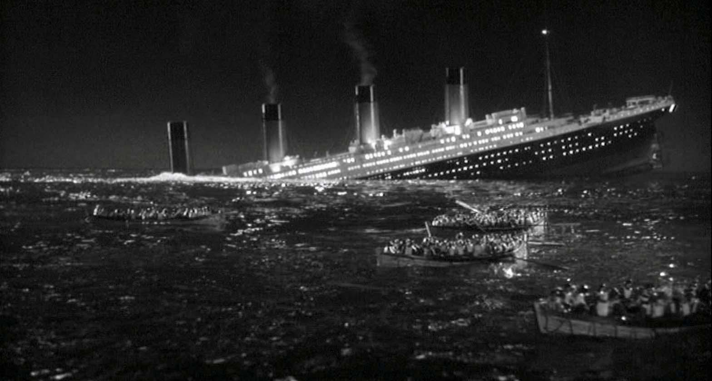
OBJECTIVE
Predict which passengers survived the Titanic shipwreck

Slide 3
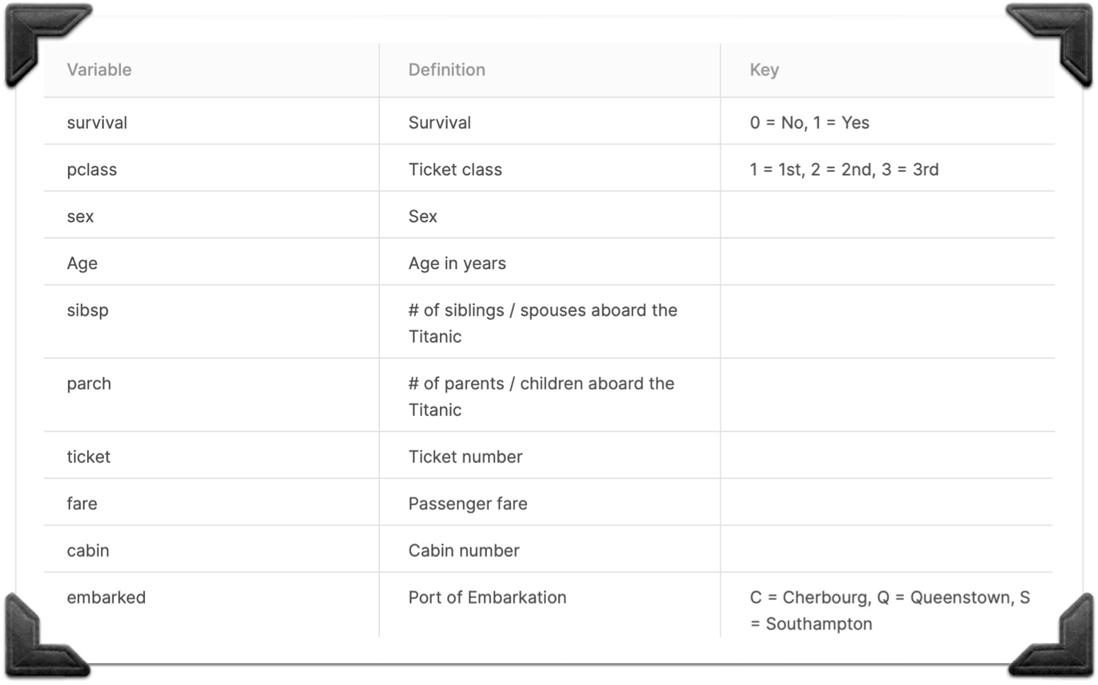
DATASET
10 variables (9 of which are independent)
Dependent variable: survival

Slide 4

APPROACH
Using Spark:
Exploratory Data Analysis
Data Cleaning
Classification algorithms
Spark pipelines
Hyperparameter tuning
Using Azure ML Service:
Deploy Azure ML Service instance
Create Automated ML run
Compare predicted results with original survival variable to understand which model is most accurate; compare the prediction performance in Spark vs. that in Azure ML

Slide 5
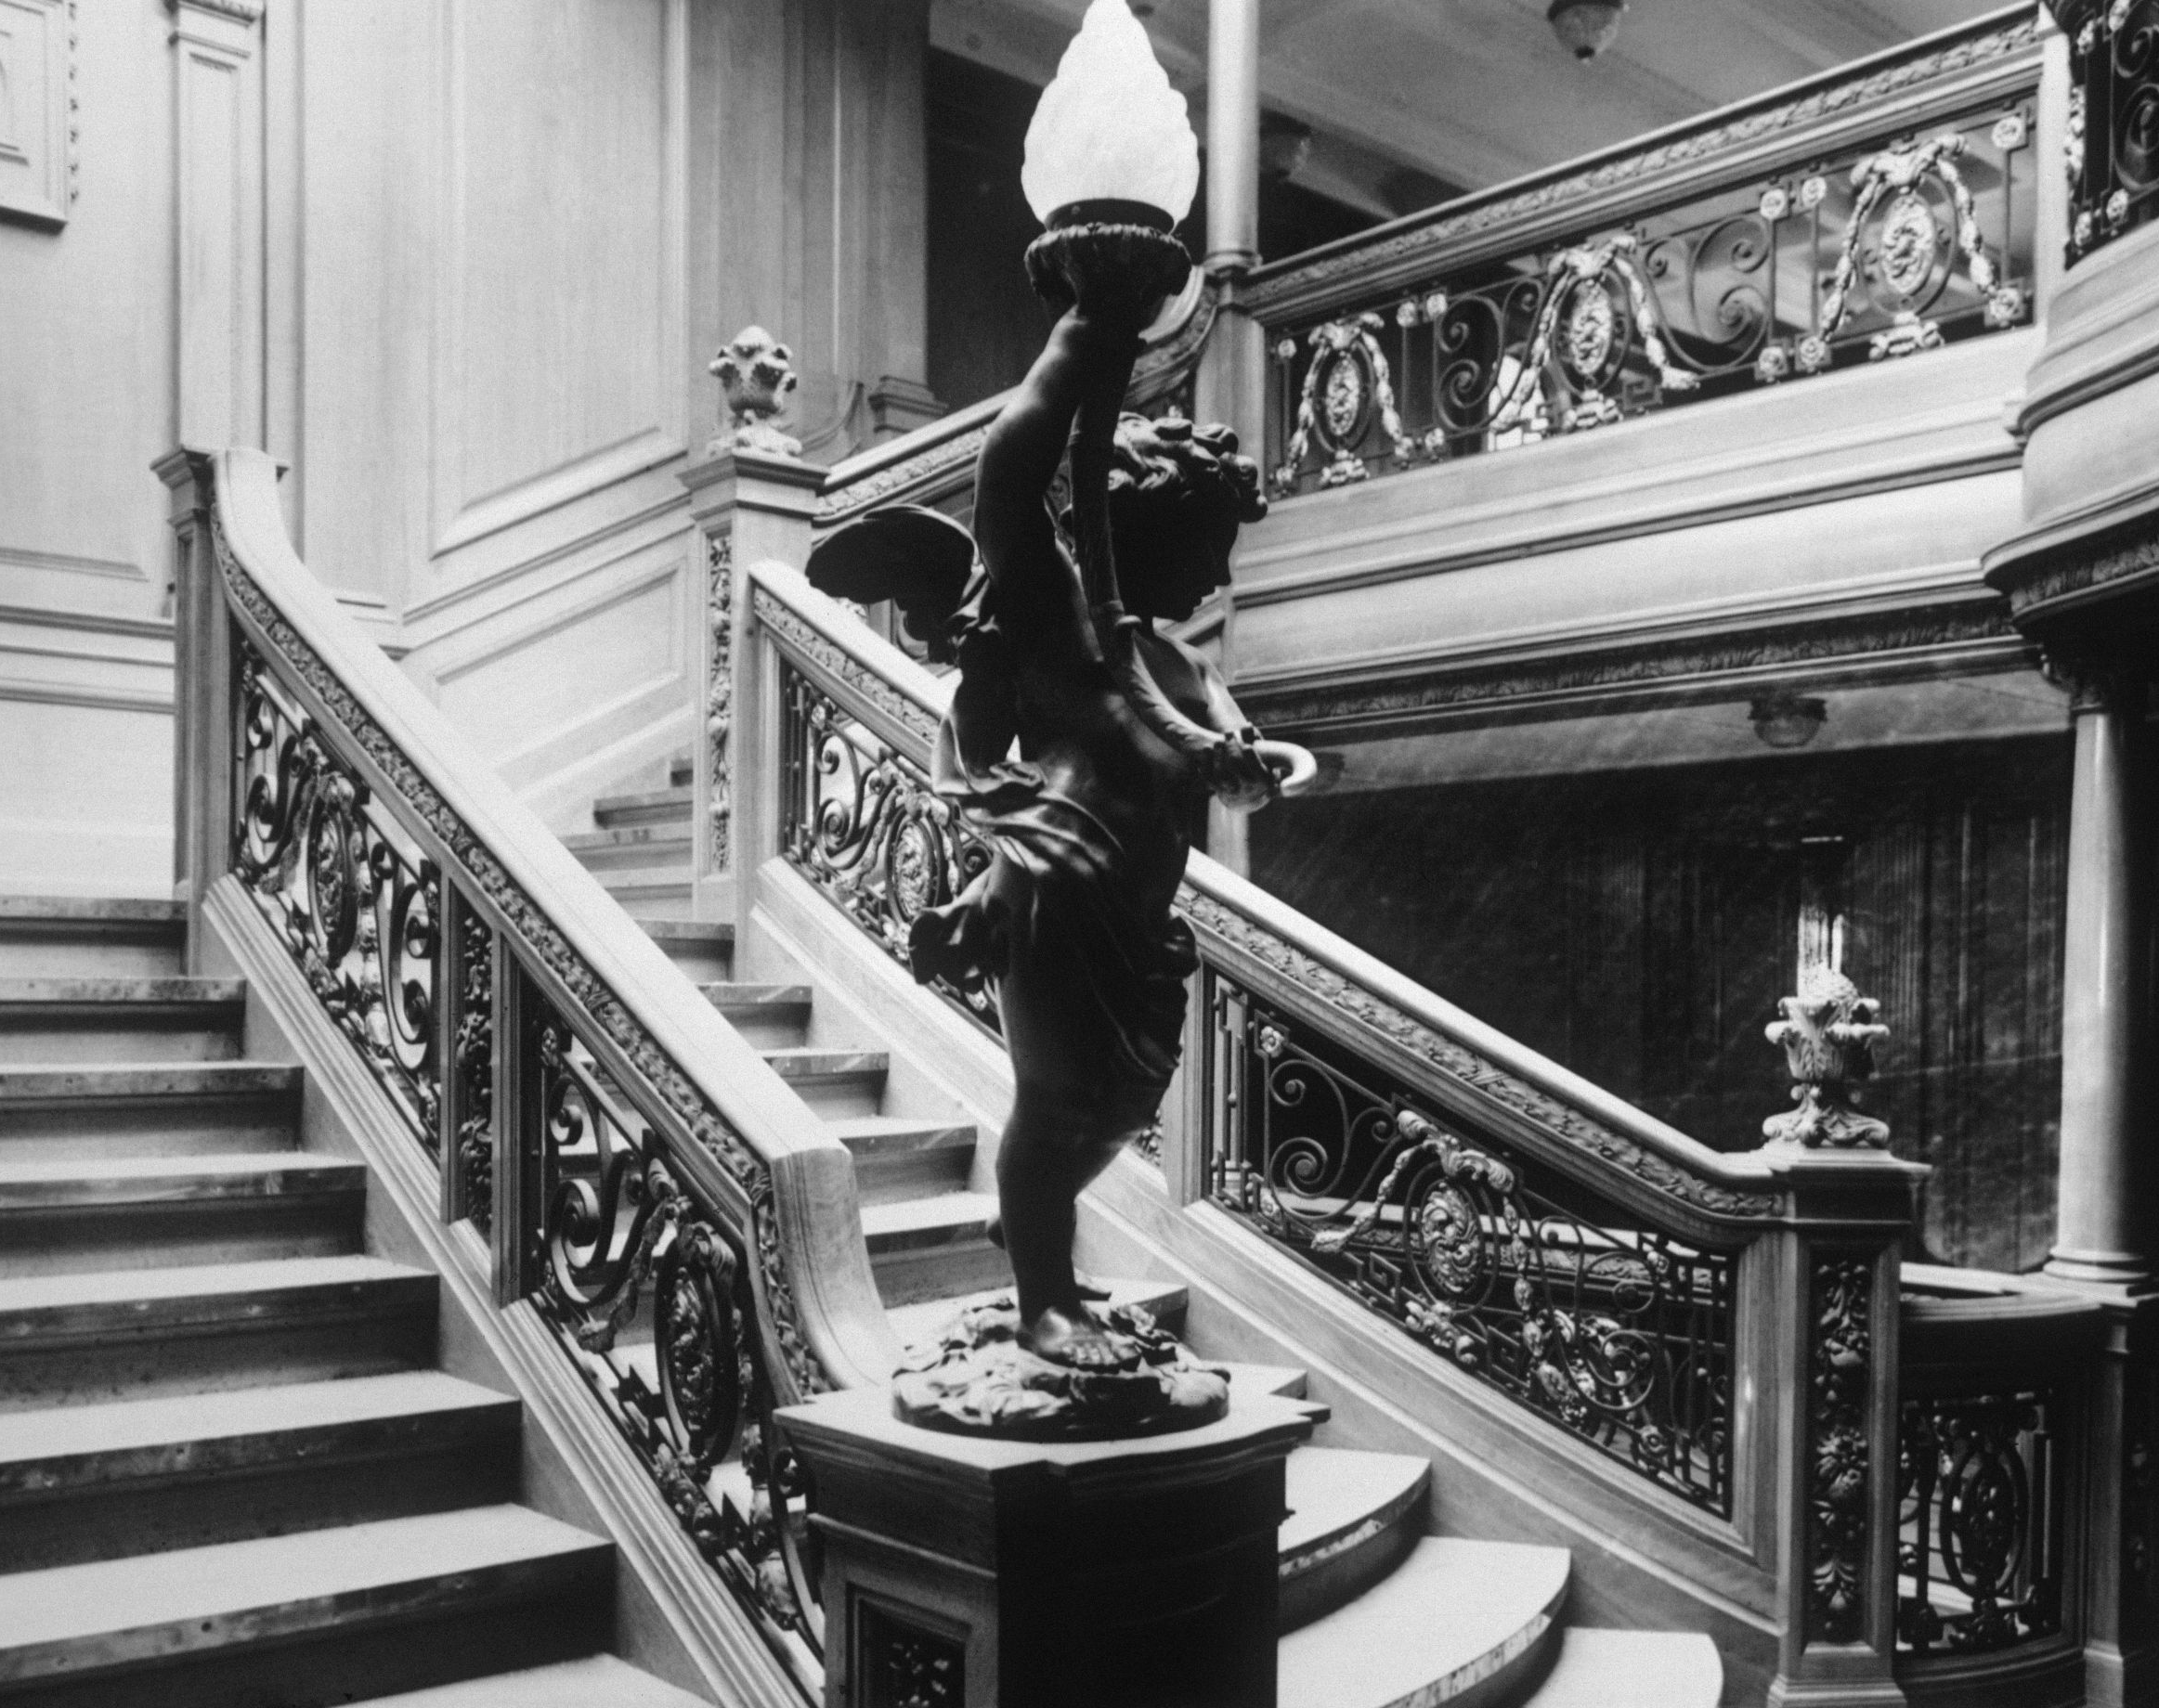
SPARK
Exploratory Data Analysis
Model Selection
Model Analysis

Slide 6
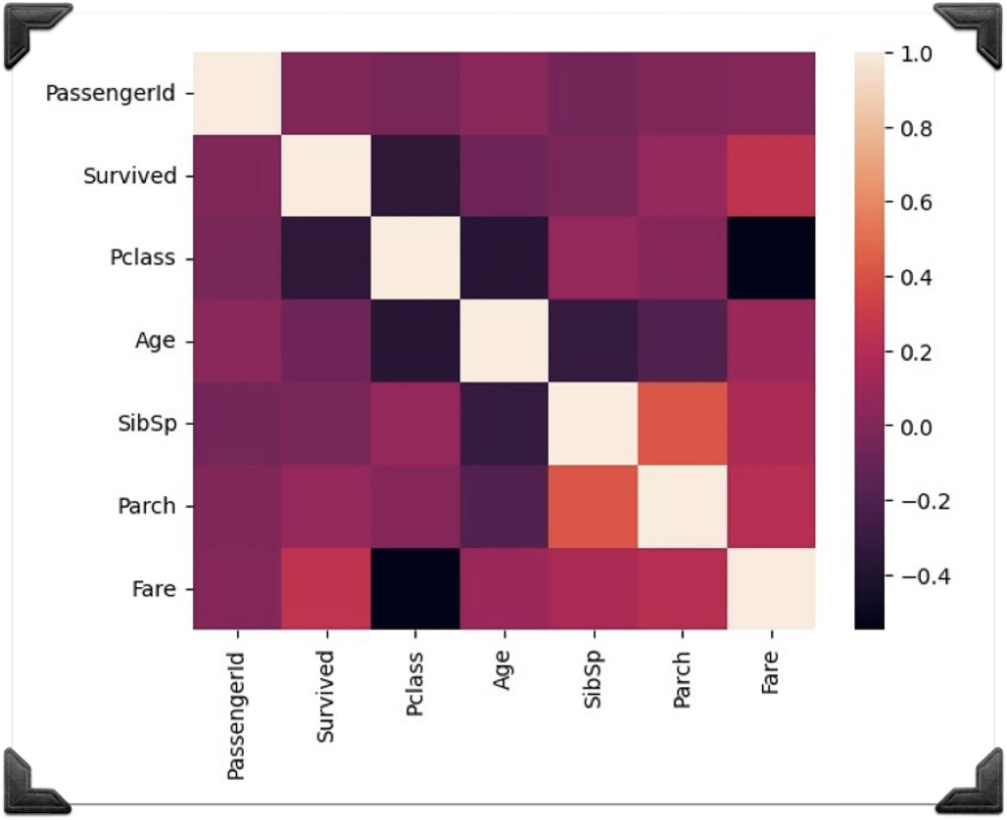
CORRELATION BETWEEN VARIABLES
The highest correlation is between number of siblings and number of parents, suggesting that a significant number are on a family trip

Slide 7
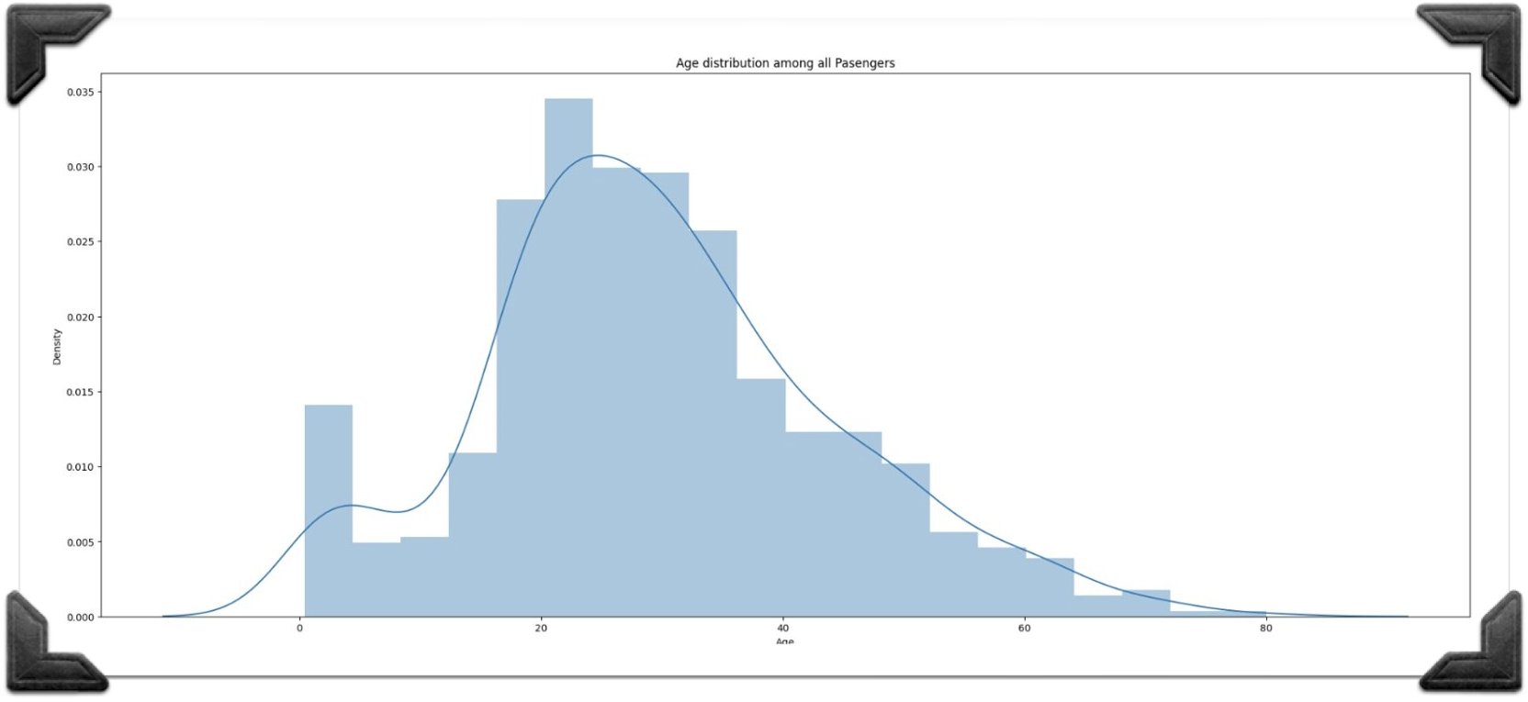
AGE DISTRIBUTION
Most passengers are between the age of 20 and 35 years
There is a low proportion of elderly passengers above 60

Slide 8
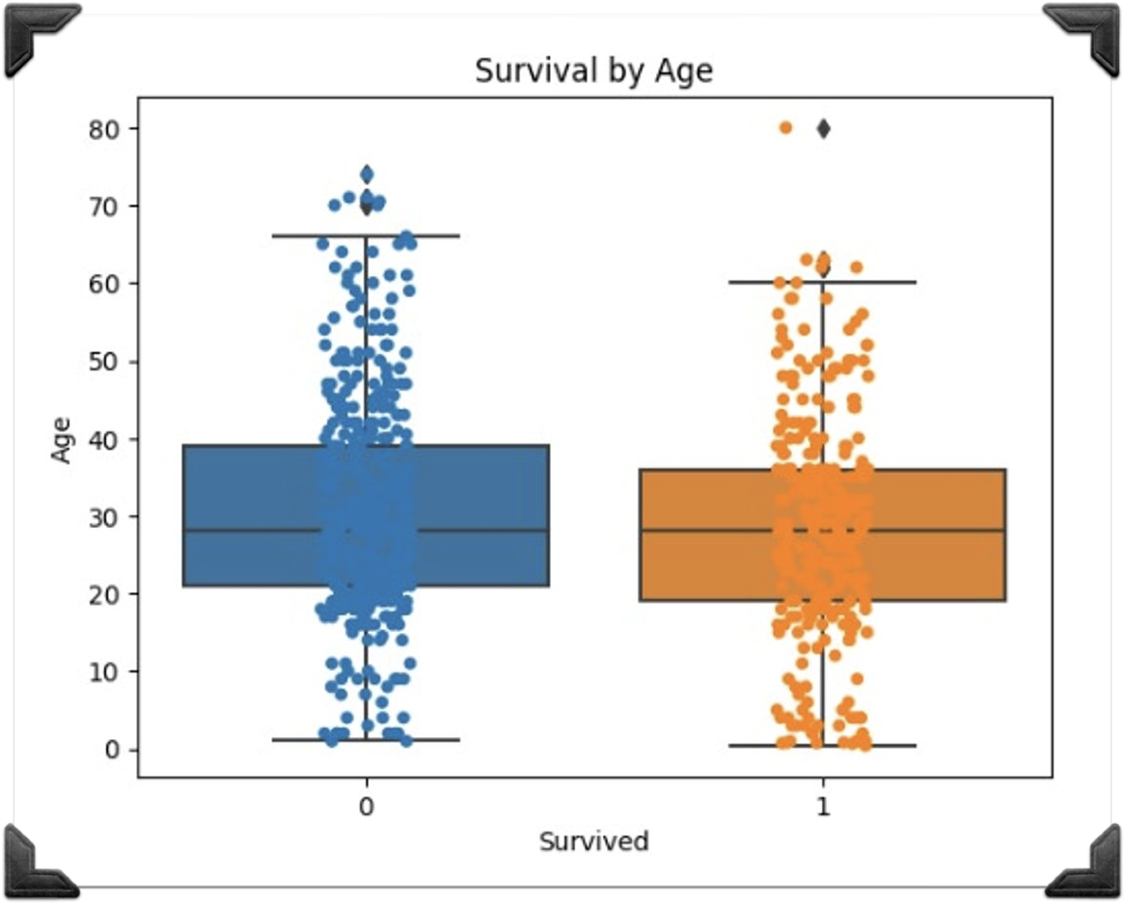
SURVIVED BY AGE
In general, the passengers who survived are slightly younger than those who passed away
However, the trends of those who did and did not survive are extremely similar to each other

Slide 9
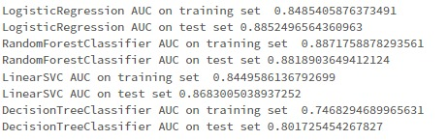
MODEL SELECTION
Logistic Regression is the preferred model, as both its training (approx. 0.85) and testing (approx. 0.89) of AUC are jointly greater than those of the others

Slide 10
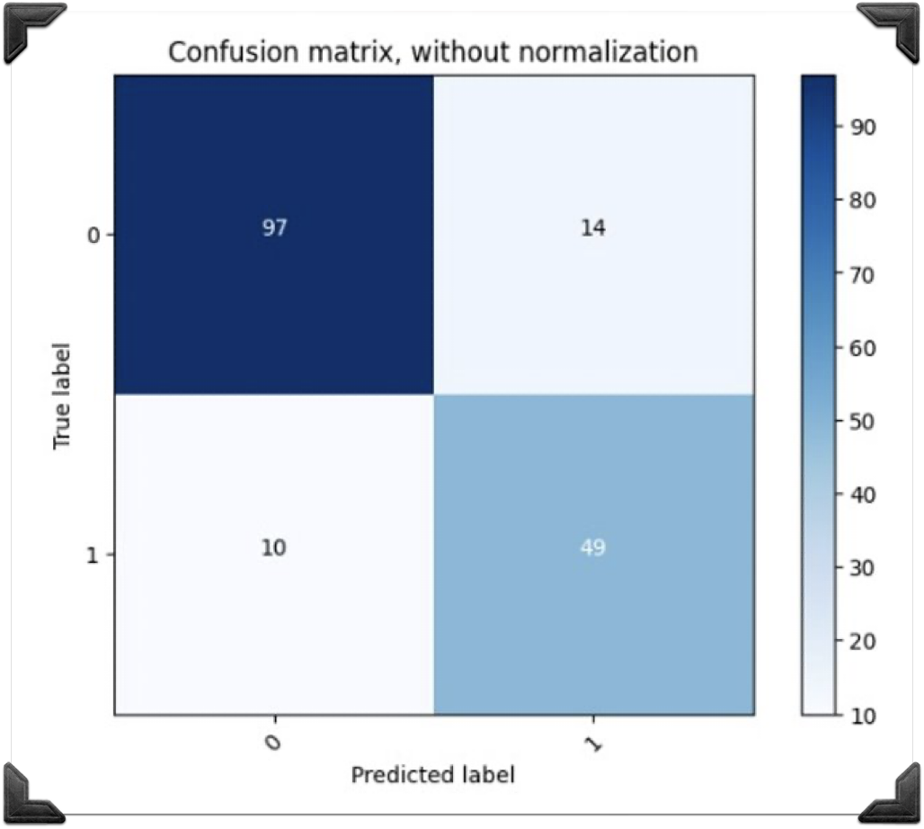
CONFUSION MATRIX OF THE LOGISTIC REGRESSION MODEL
The sensitivity of our model is 0.83, which means it correctly identifies 83% of the positive cases
Th result indicates the model has a high ability to detect and classify passengers that survived
The specificity of our survival classification model is 0.87, indicating that it accurately identifies 87% of the non-survival cases
The result suggests that the model performs well in classifying passengers that did not survive

Slide 11
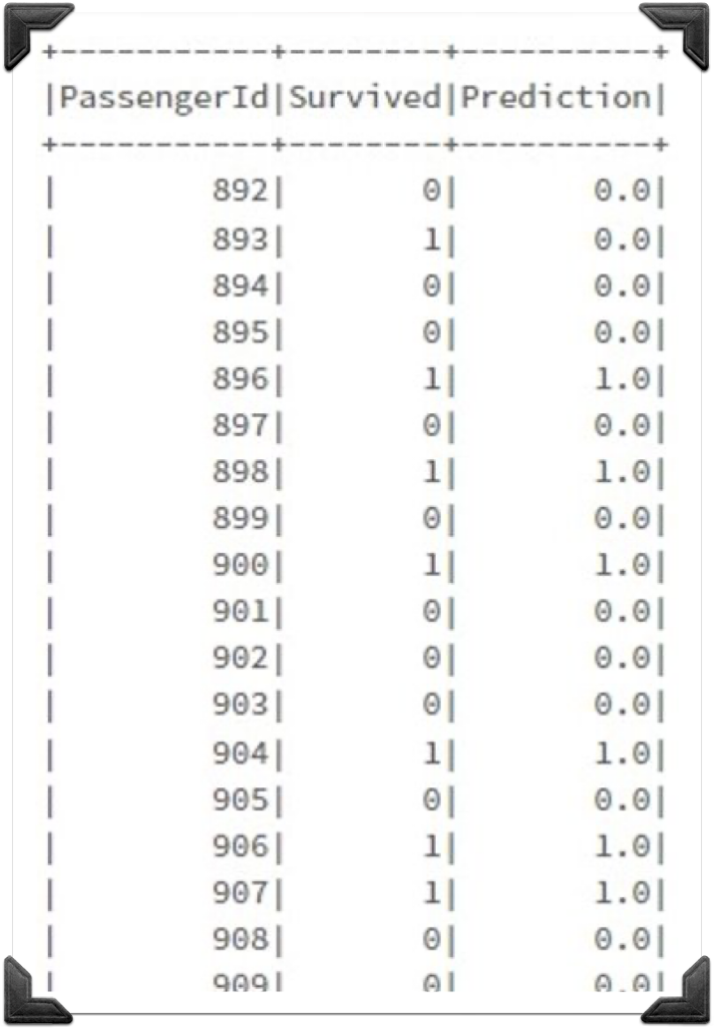
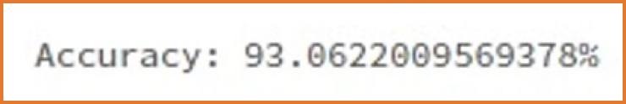
ACTUAL LABELS VS. PREDICTIONS
Left: the final dataframe where the actual labels are compared to the predictions of the test dataframe
Top: the final prediction accuracy is 93%

Slide 12
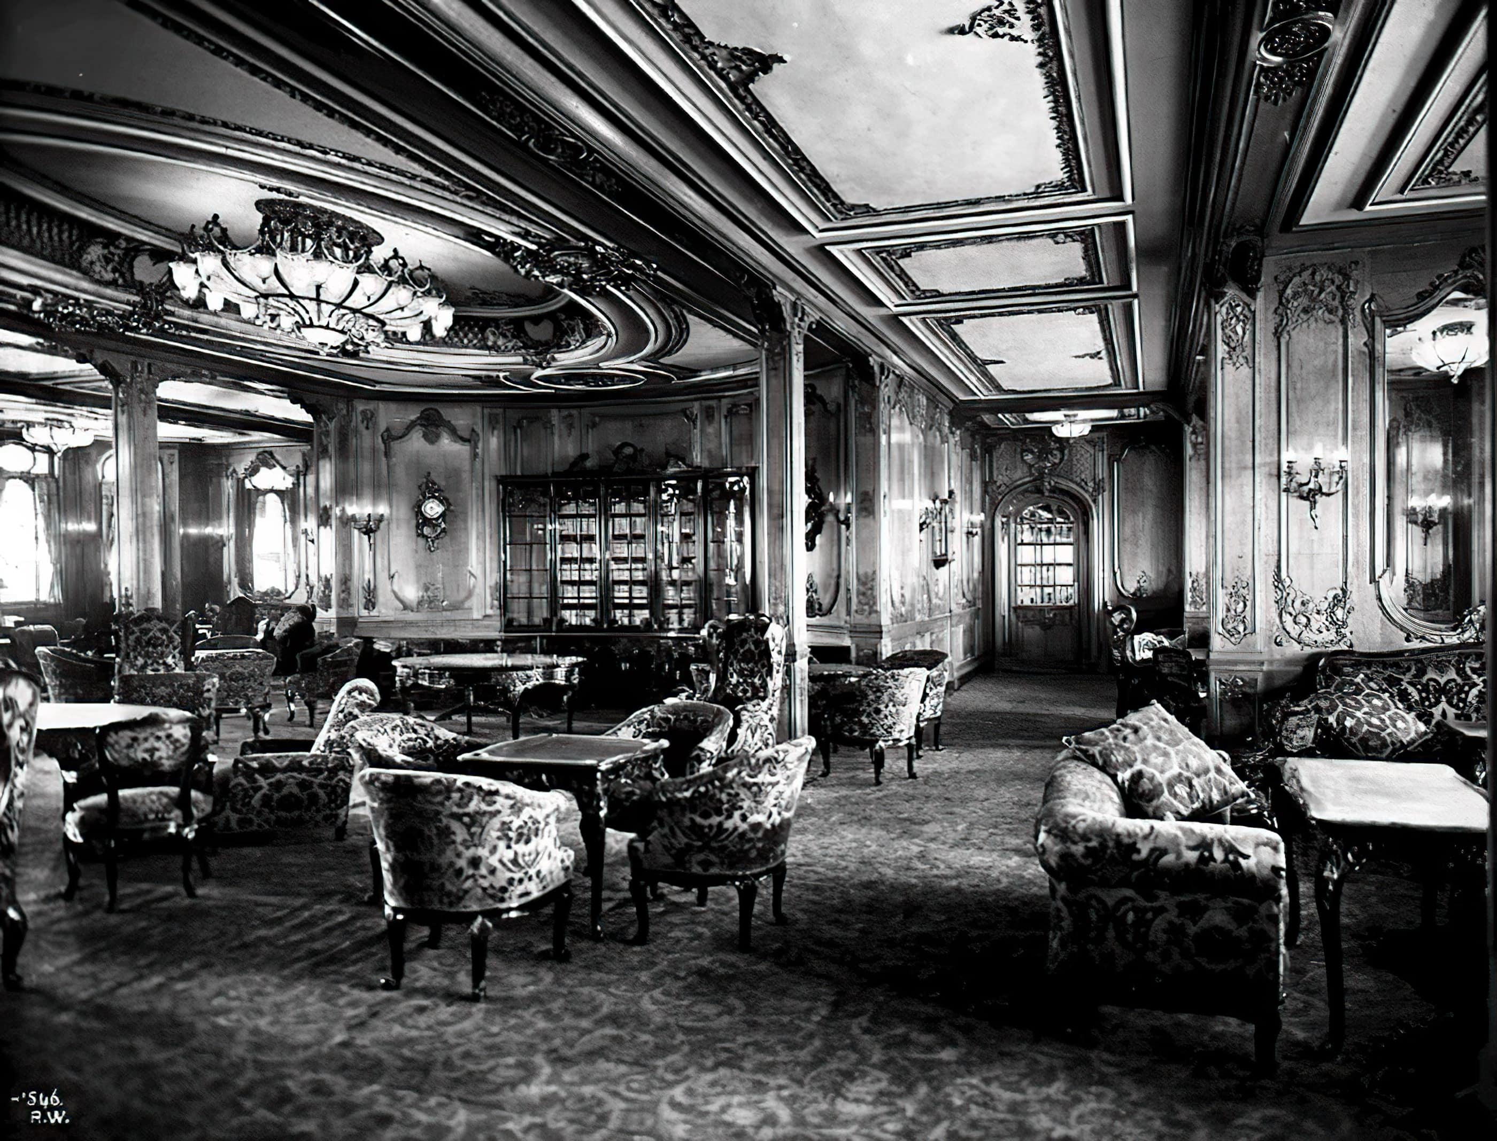
AZURE – AUTO ML
Model Selection
Model Analysis

Slide 13
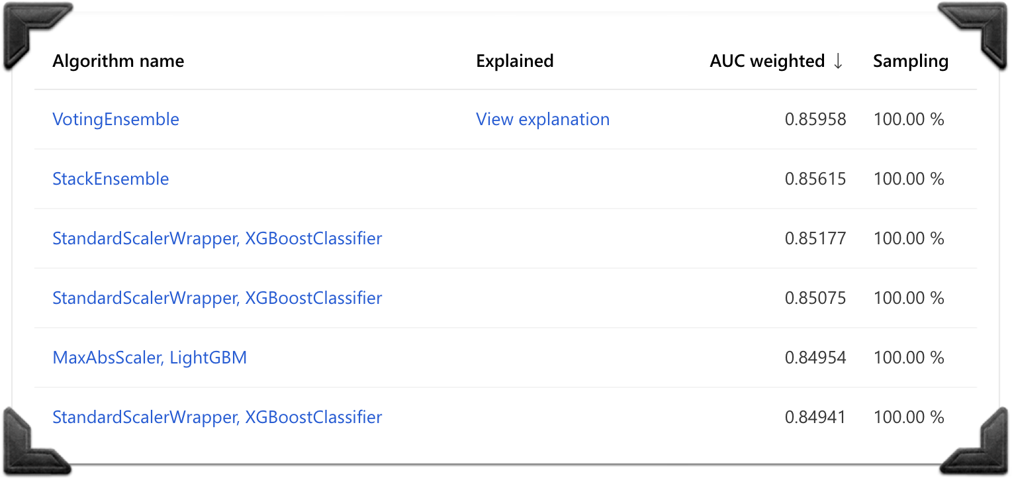
ALGORITHMS
Over 40 algorithms were run
VotingEnsemble was the most accurate algorithm, with an AUC weight of approx. 0.86

Slide 14
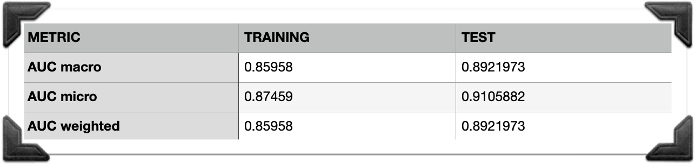
BEST MODEL RUN METRICS: VOTINGENSEMBLE
Strong performance and good generalization: High accuracy, AUC, precision, recall, and F1 scores in predicting Titanic survivors
Effective discrimination: AUC scores range from 0.85 to 0.90

Slide 15
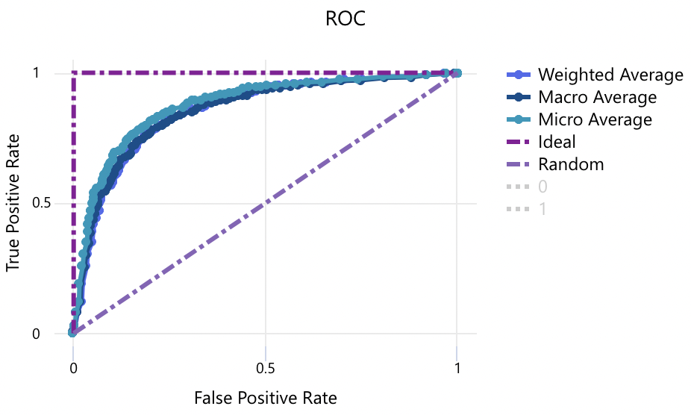
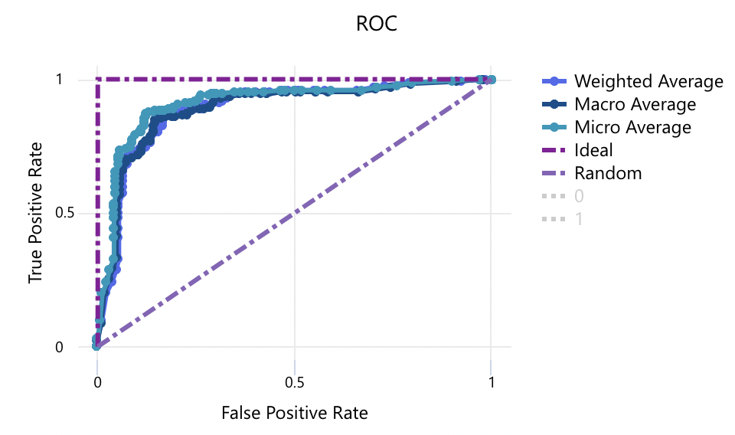
BEST MODEL RUN METRICS: VOTINGENSEMBLE (CONT.)
Precise identification: High precision, recall, and F1 scores for both datasets
Well-calibrated probabilities: Low log loss values indicate accurate predictions
Reliable correlation: Matthews Correlation Coefficient shows a strong relationship between predictions and true labels
TRAINING
TEST

Slide 16
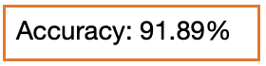
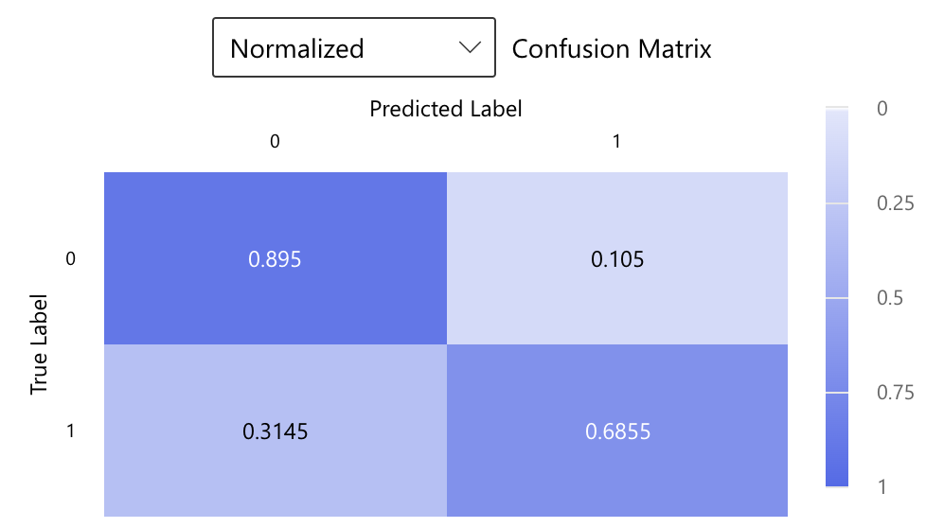
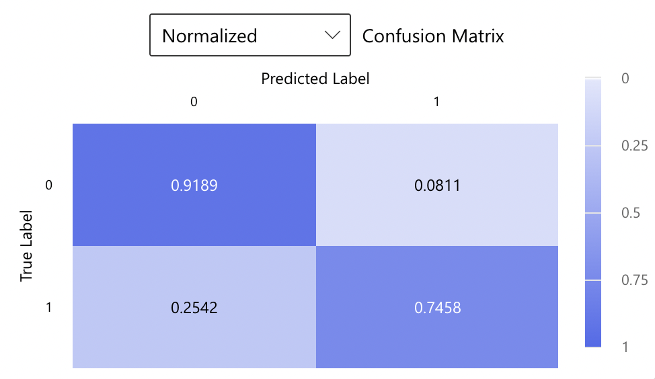
ACTUAL LABELS VS. PREDICTIONS CONFUSION MATRIX: TRAINING AND TEST
In both training and test, considerable portion of instances that are actually 1 are misclassified as 0
The model correctly predicts instances labeled as 1 for the majority of cases
Overall, the model seems to have a higher accuracy in predicting instances labeled as 0 compared to instances labeled as 1
The final prediction accuracy is 92%
TRAINING
TEST

Slide 17
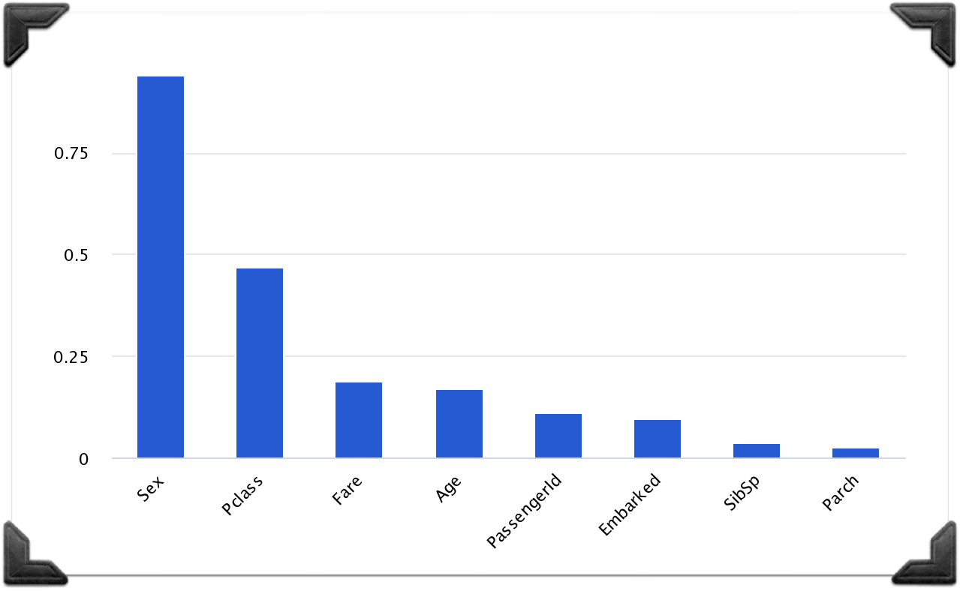
AGGREGATE FEATURE IMPORTANCE
According to the model, Sex is the most impactful feature in terms of who survived, around twice as significant as the second most impactful, Pclass

Slide 18
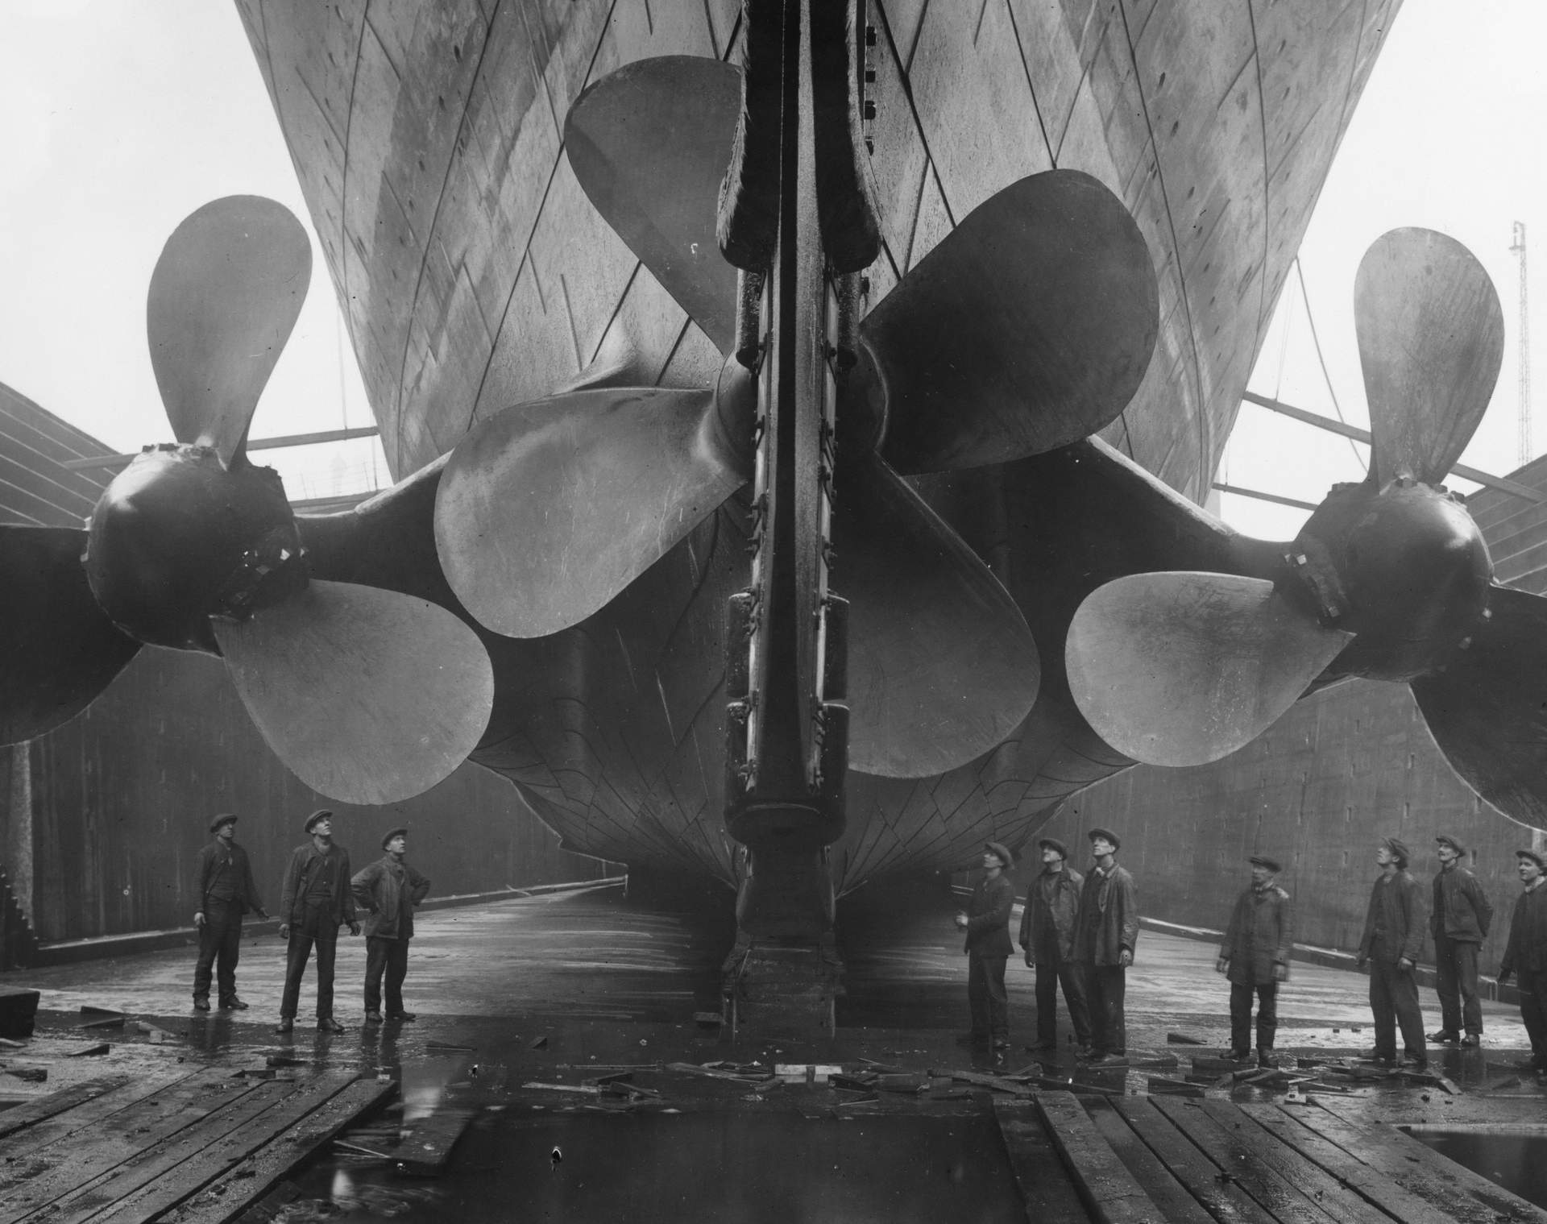
COMPARISON BETWEEN THE MODELS EMPLOYED
Spark
Azure – Auto ML

Slide 19
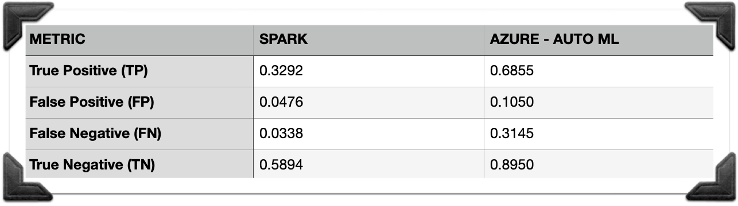
SPARK MODEL VS. AZURE – AUTO ML MODEL
CONFUSION MATRICES (NORMALIZED)
The Azure – Auto ML model has higher numbers (normalized) across all metrics; while it performs better than Spark's model on the positives, it also performs worse on the negatives
Moreover, both models project similar AUC values, around 0.85 (training) and 0.89 (test), which indicate good discrimination ability from sides
Overall, the Spark model has a higher accuracy of approx. 93% vs. Azure – Auto ML's accuracy of approx. 92%

Slide 20
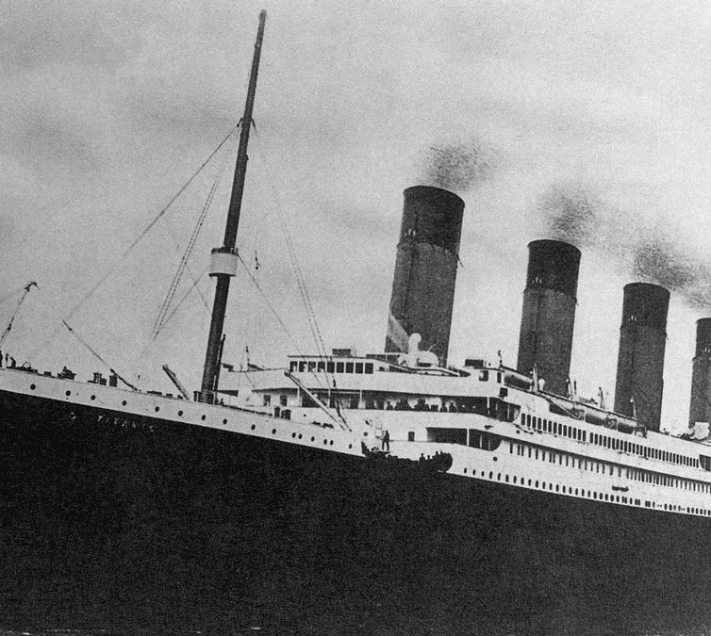
THE BEST MODEL OF SPARK VS. THAT OF AZURE - AUTO ML
Both models generally provided accurate predictions and similar numbers
The slight differences may be down to the differences in algorithms, effective feature engineering, and optimized hyperparameters
Spark's use of LogisticRegression has shown to be a favourable approach
Overall, Spark's model has shown to be slightly better in predicting who survived the Titanic disaster

Slide 21

THANK YOU!
Alejandro Acosta, Henry Becerra, Adel Reka Kalozdi, Karim Khazzaka, Roberto Antonio Mapa

